Slide 1
Variable, Arrays, String, Constant

Slide 2
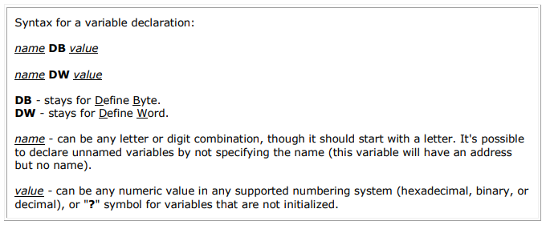
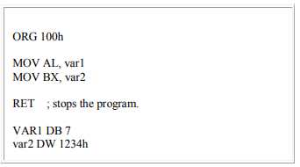
Variables
Our compiler supports two types of variables: BYTE and WORD.

Slide 3
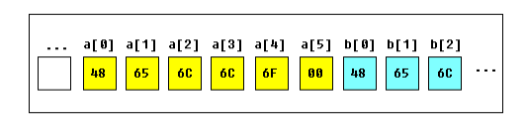
Arrays
Arrays can be seen as chains of variables. A text string is an example of a byte array; each character is presented as an ASCII code value (0..255).
a DB 48h, 65h, 6Ch, 6Ch, 6Fh, 00h
b DB 'Hello', 0
b is an exact copy of the array; when the compiler sees a string inside quotes, it automatically converts it to a set of bytes. This chart shows a part of the memory where these arrays are declared:

Slide 4
Arrays
You can access the value of any element in array using square brackets, for example:
MOV AL, a[3]
You can also use any of the memory index registers BX, SI, DI, BP, for example:
MOV SI, 3
MOV AL, a[SI]

Slide 5
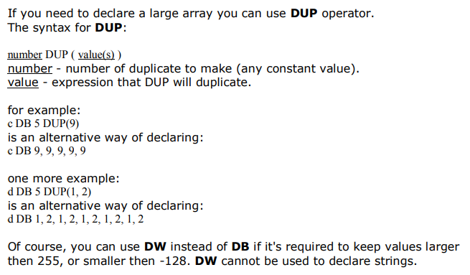
Arrays

Slide 6
Arrays
array DW 10, 20, 30, 40, 50
mov si, 0
loop_start:
mov ax, array[si] ; Load array element at index si into AX
; Do something with the element in AX, e.g., print it
; (printing code not shown in this example)
inc si ; Move to the next index
cmp si, 5 ; Compare with the number of elements in the array
jl loop_start

Slide 7
Arrays
.MODEL SMALL
.STACK 100h
.DATA
ARR DB 1,2,3,4,5 ;array declaration
.CODE
MAIN PROC
MOV AX,@DATA
MOV DS,AX
MOV CX,5
MOV SI,0
MOV AH,2
OUTPUT:
MOV DL, ARR[SI]
ADD DL, 30H ;convert to asking
INT 21H
INC SI
LOOP OUTPUT
MAIN ENDP
END MAIN

Slide 8
.MODEL SMALL: This directive specifies the memory model to be used for the program. In this case, the SMALL memory model is used, which is commonly used for simple programs.
.STACK 100h: This directive reserves a stack size of 100 bytes for the program. The stack is used for temporary storage of data during subroutine calls and other operations.
.DATA: This section is used for declaring data variables and constants.
ARR DB 1,2,3,4,5: This line declares an array named ARR and initializes it with the values 1, 2, 3, 4, and 5.
.CODE: This section contains the actual assembly code instructions.
MAIN PROC: This marks the beginning of the main procedure.
MOV AX, @DATA: This instruction loads the segment address of the data segment into the AX register.
MOV DS, AX: This instruction moves the value of the AX register (which contains the segment address of the data segment) into the DS (Data Segment) register. This sets up the DS register to point to the data segment, allowing access to the declared data.

Slide 9
MOV CX, 5: This initializes the CX register with the value 5. It will be used as a counter for looping through the array.
MOV SI, 0: This initializes the SI (Source Index) register with the value 0. It will be used as an index to access elements in the array.
MOV AH, 2: This sets up the AH register with the value 2. In the context of the DOS interrupt 21H, AH=2 is used to specify a character output function.
OUTPUT:: This is a label that marks the beginning of a loop named "OUTPUT".
MOV DL, ARR[SI]: This instruction loads the byte at the memory location pointed to by DS:SI (DS multiplied by 16 + SI) into the DL register. This effectively loads an element from the array into DL.
ADD DL, 30H: This adds the ASCII value of '0' (30H in hexadecimal) to the value in DL. This converts the numerical value in DL to its ASCII representation.
INT 21H: This triggers a software interrupt 21H (DOS interrupt). The value in AH specifies the function to be executed, which in this case is AH=2 (character output). The character in DL will be displayed on the screen.
INC SI: This increments the value in the SI register, effectively moving to the next element in the array.
LOOP OUTPUT: This instruction decrements the CX register and, if CX is not zero, transfers control back to the "OUTPUT" label. This creates a loop that iterates through the array of elements.
MAIN ENDP: This marks the end of the main procedure.
END MAIN: This marks the end of the program.

Slide 10
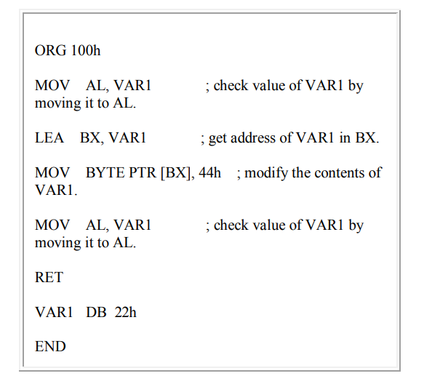
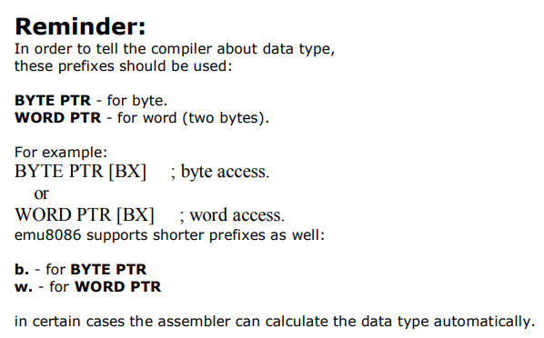
Getting the Address of a Variable
There is LEA (Load Effective Address) instruction and alternative OFFSET operator. Both OFFSET and LEA can be used to get the offset address of the variable.
LEA is more powerful because it also allows you to get the address of an indexed variables. Getting the address of the variable can be very useful in some situations,
for example when you need to pass parameters to a procedure.

Slide 11
Conditional statements(if else)
ORG 100h ; Origin address where the program will be loaded
MOV AH, 0 ; Clear AH register
MOV AL, 5 ; Load AL with the number to be checked
CMP AL, 0 ; Compare AL with 0
JG Positive ; Jump to Positive if AL > 0
JZ NonPositive ; Jump to NonPositive if AL = 0
Positive:
; Print "Positive" message (you need to implement printing routine)
; For example, you could use DOS interrupt 21h to print the message
; AH = 9, DX points to the string
MOV AH, 9
LEA DX, PositiveMsg
INT 21h
JMP EndProgram ; Jump to the end of the program
NonPositive:
; Print "Non-Positive" message
MOV AH, 9
LEA DX, NonPositiveMsg
INT 21h
EndProgram:
; Exit the program
MOV AH, 4Ch
INT 21h
PositiveMsg DB "Positive$", 0
NonPositiveMsg DB "Non-Positive$", 0
RET
END

Slide 12
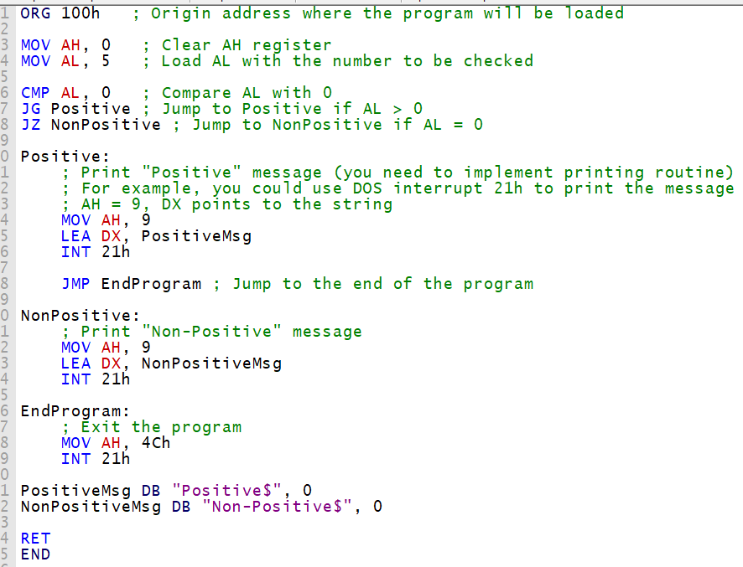
Conditional statements(if else)

Slide 13
Conditional statements(if else)
"Positive$" and "Non-Positive$": These are the actual string values that you want to store in memory. The $ symbol indicates the end of the string. Strings in assembly are often null-terminated, meaning they are followed by a null (0) byte to mark the end of the string.
0: This is the null byte that terminates the string. It's added at the end of each string to indicate the end of the string.

Slide 14
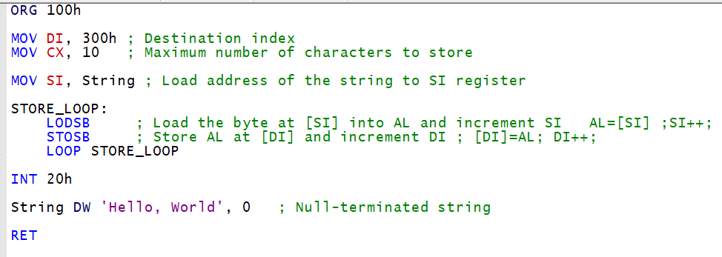
String operations(LODSB,STOSB)

Slide 15
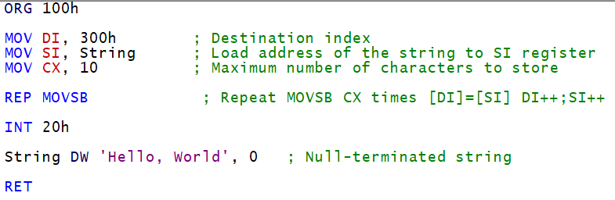
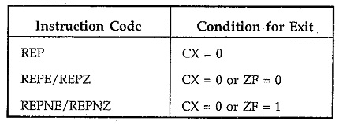
String operations and rep instruction

Slide 16
